Slide 1
Reminders...
You’ll use this file for the entirety of this capstone. Save it in a place where you can easily access it over the upcoming weeks.
You can edit and save this document in Google Drive
If you download this document, keep it in a place you can find it later
The content you put into this document will be used later
It is recommended that you do not skip any capstone readings
Feel free to customize this slide deck to make it your own, but make sure to answer all the questions in the prompts
Requirements:
Answer all the questions in this document
When complete, download this as a PDF document for submission in the peer review assignment.
Don’t know how to download as a PDF? You can find more information about downloading this by clicking here.
Remove this slide before submitting

Slide 2
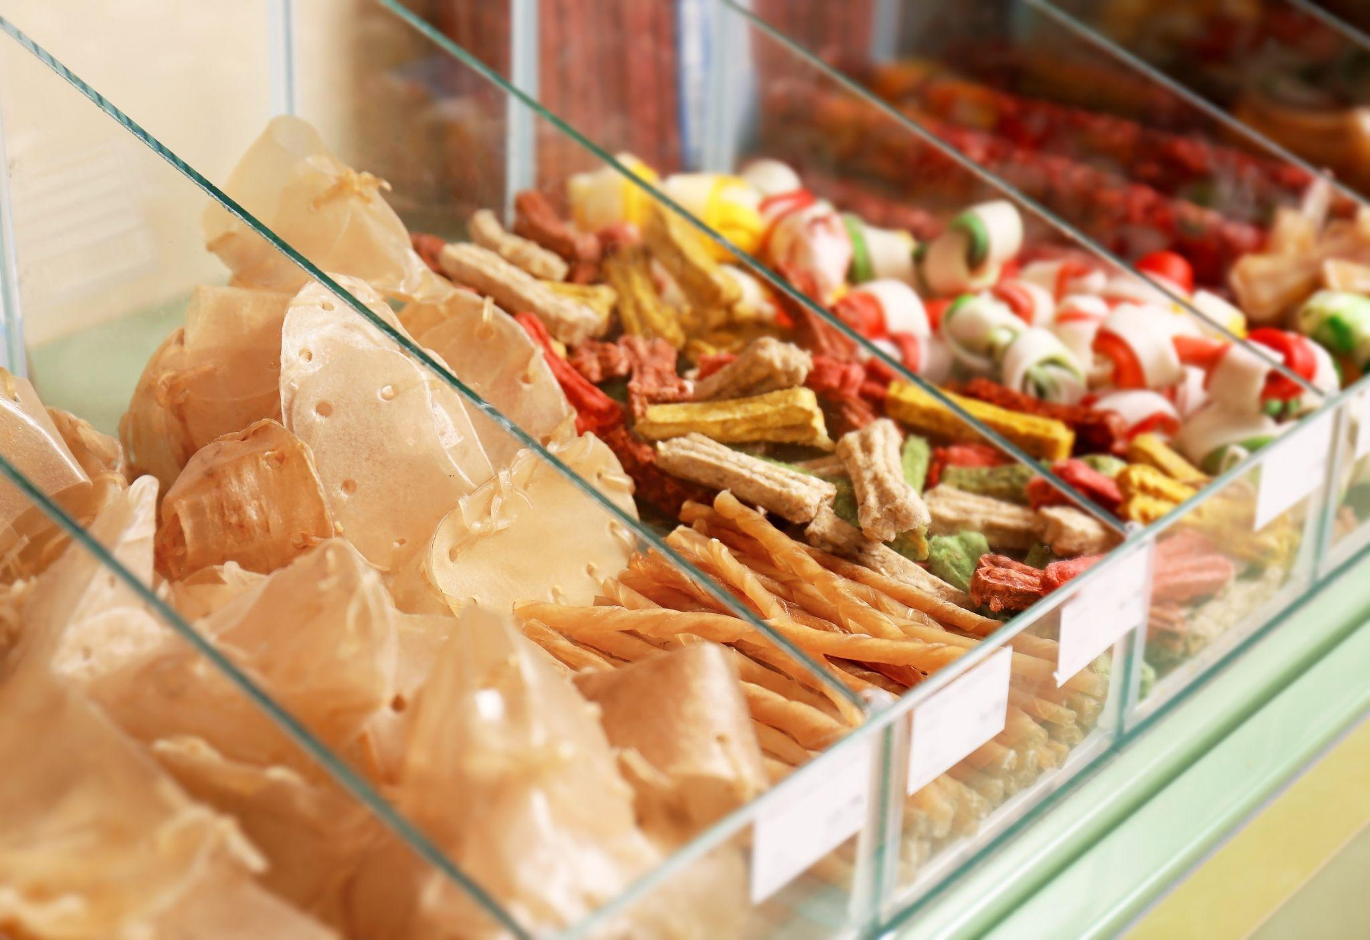

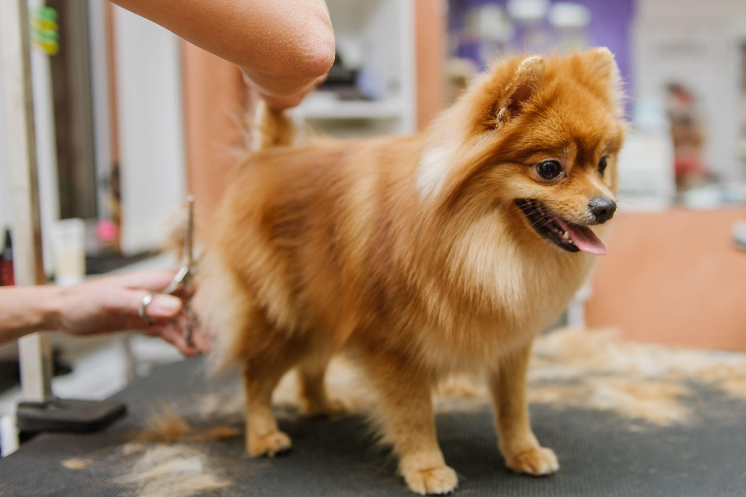

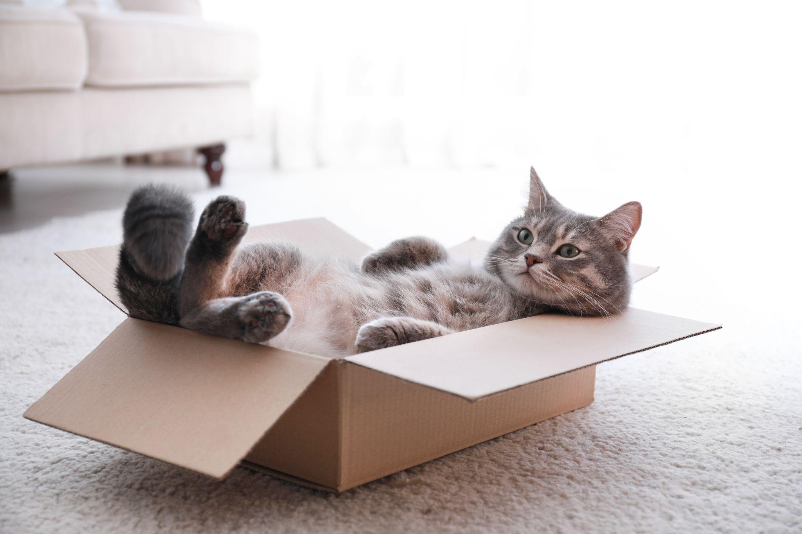
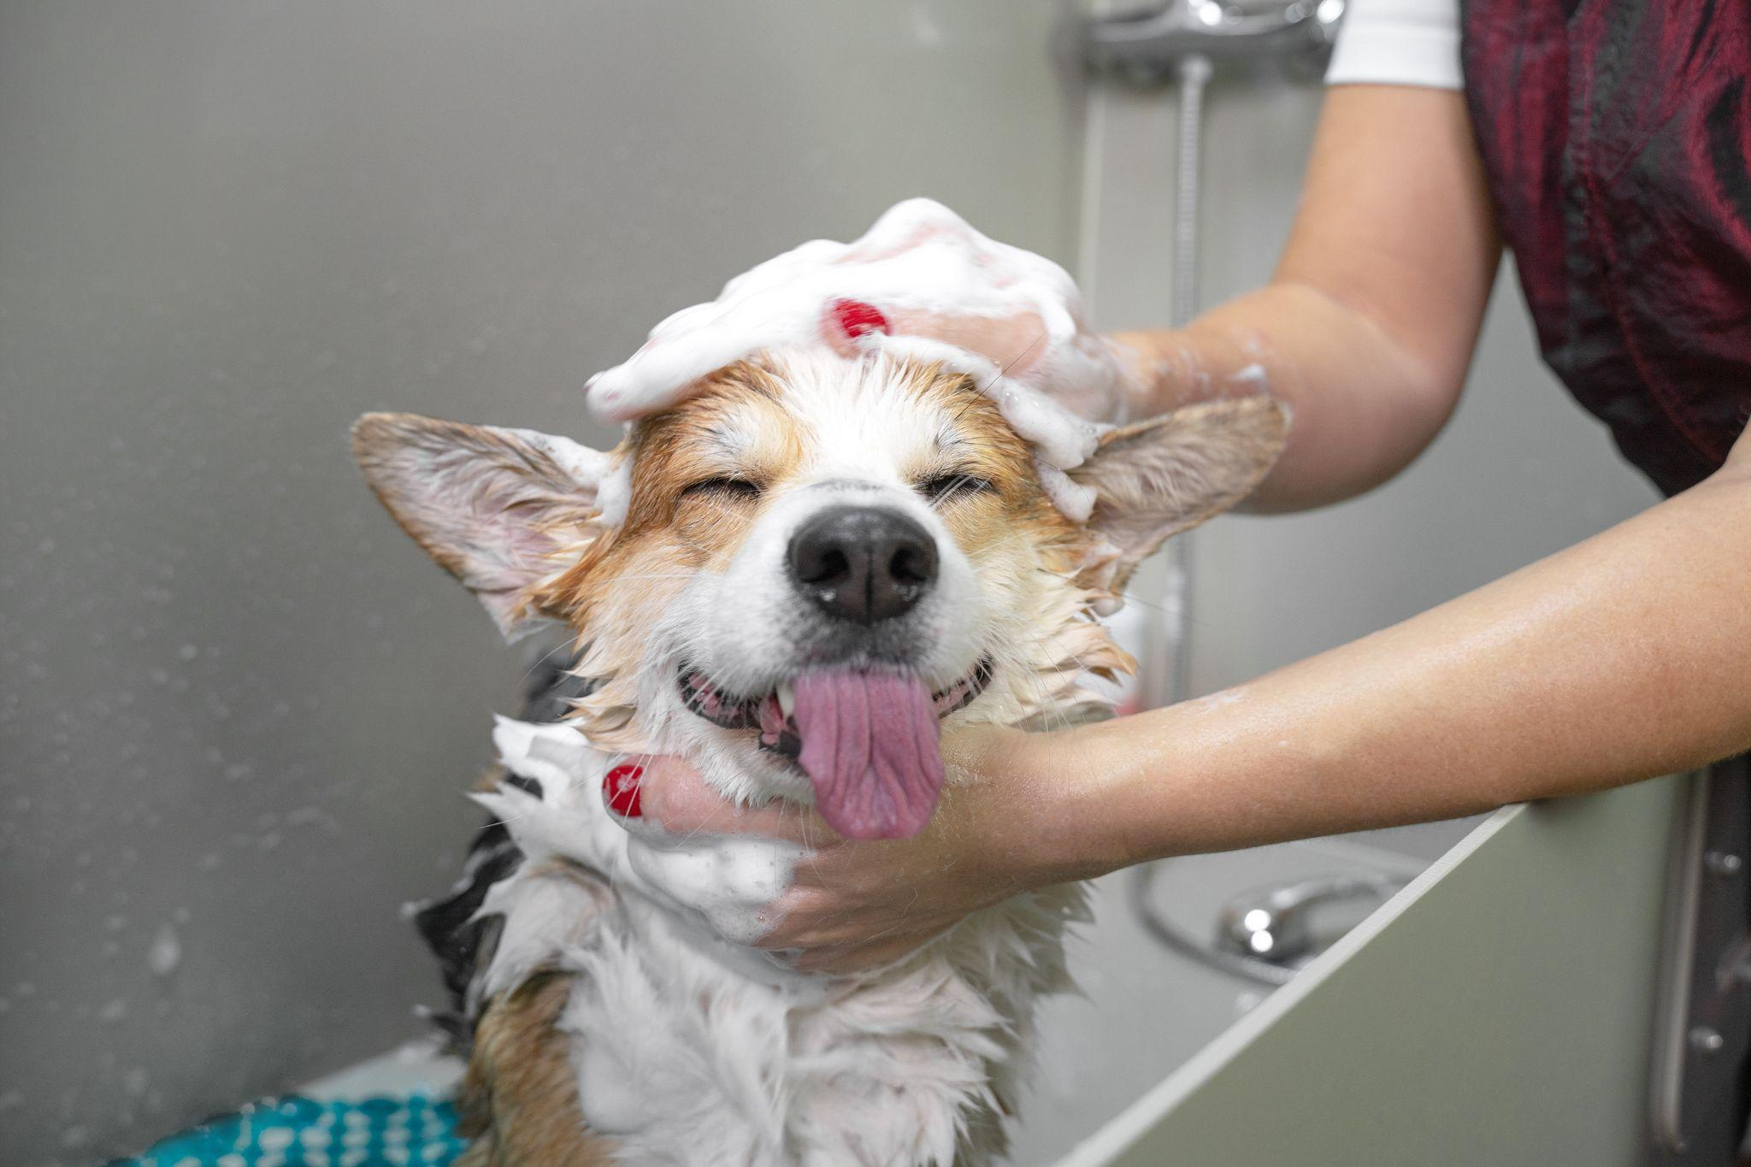
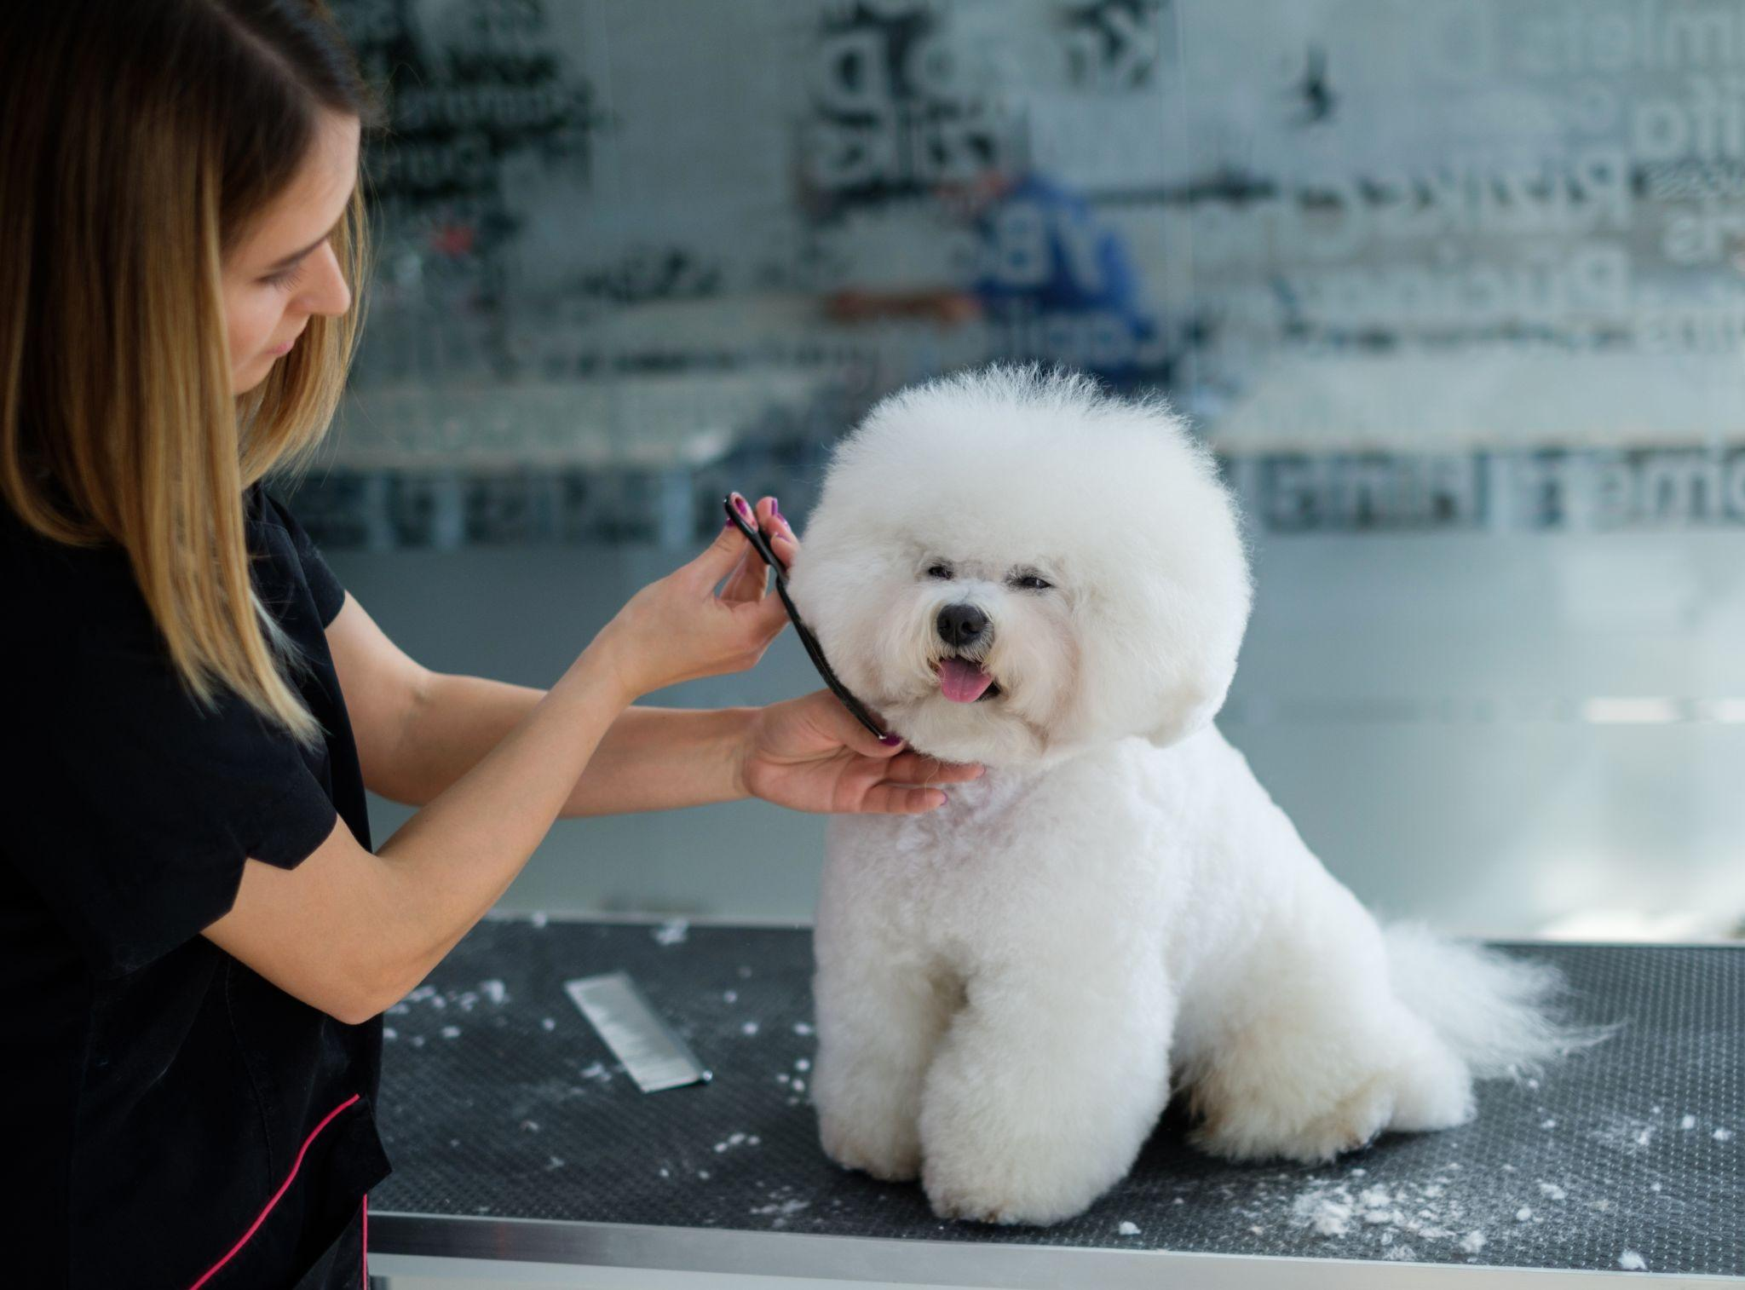
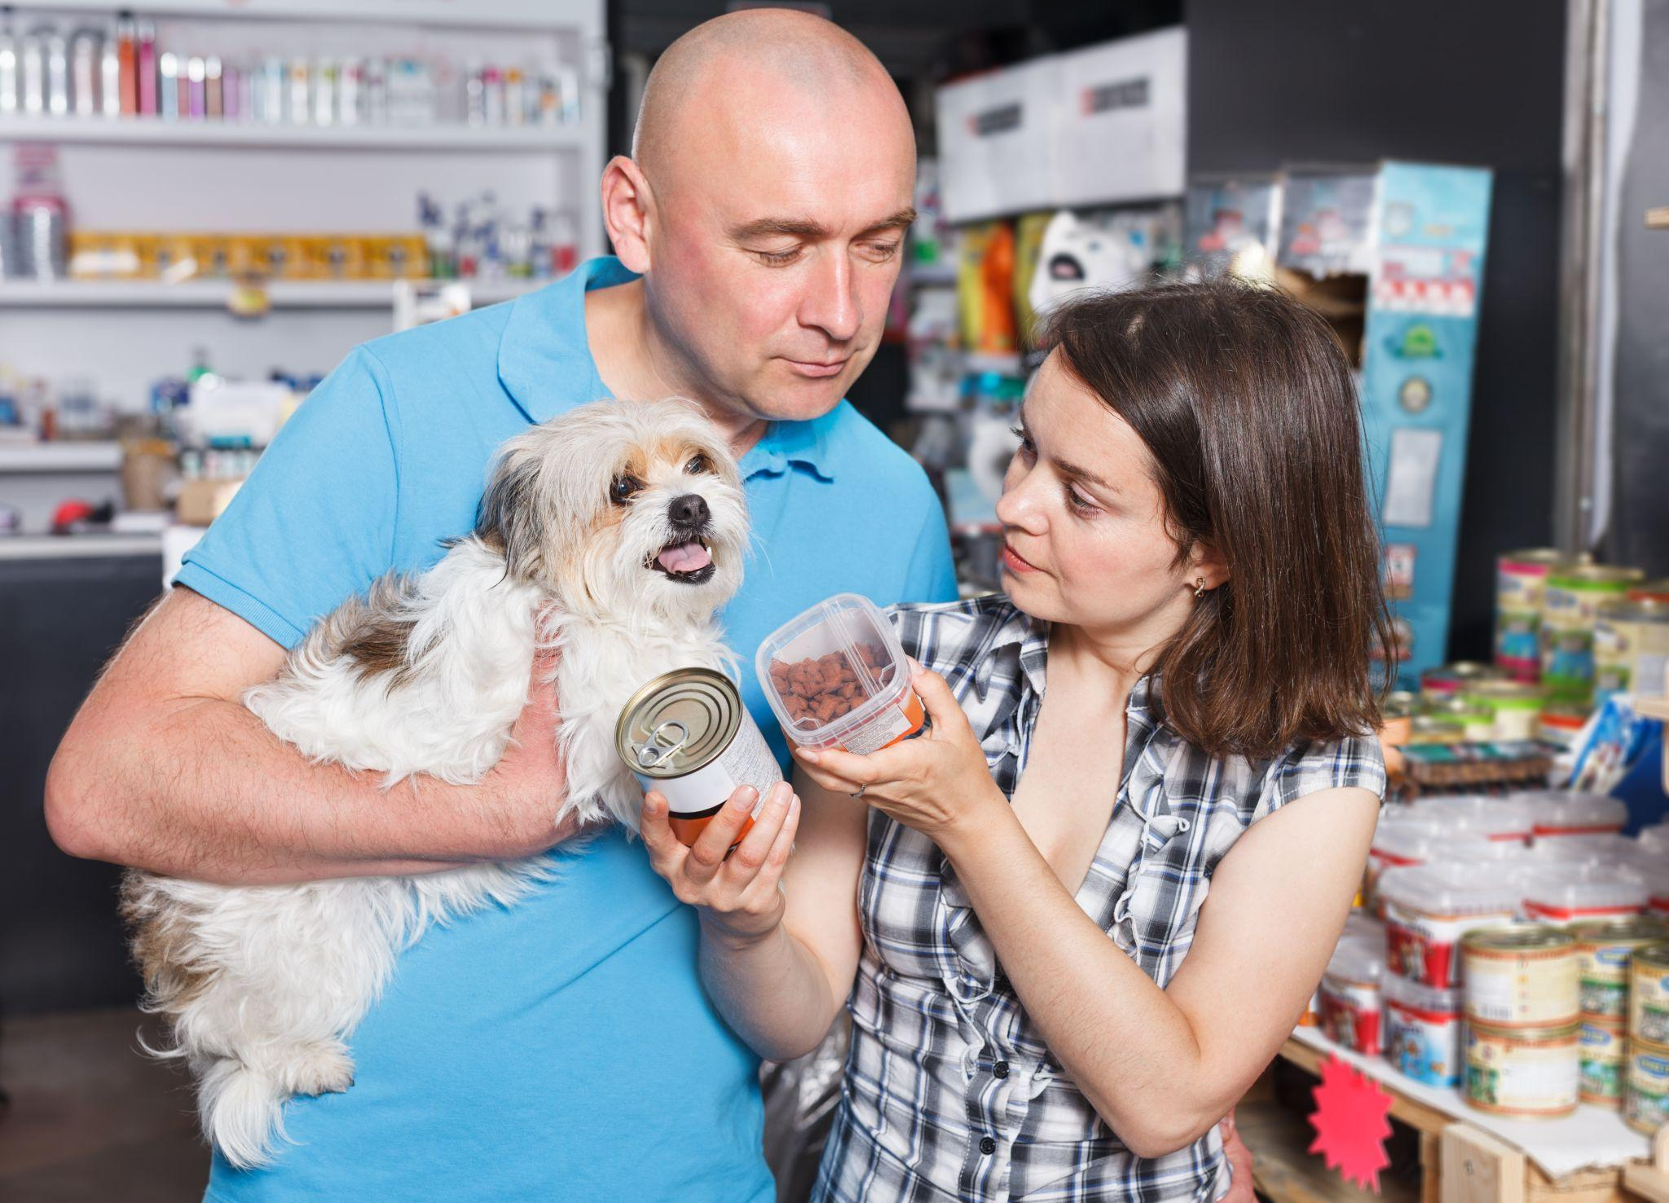
Images from Inu + Neko
Here are a few images that can be used throughout your deck that are part of the Inu + Neko image library.

Slide 3

Course 2 Capstone
The OSEMN Process

Slide 4
Your Approach 1 of 4
Give at least two example questions you would want to answer as an analyst that relates to Inu + Neko’s business problem.
Remember a good question includes a focus on something that is actionable and follows the SMART goal principles (specific, measurable, attainable, relevant, & timely).
Enter your answer here:

Slide 5
Your Approach 2 of 4
What information do you think would be particularly important to your analysis for Inu + Neko?
Enter your answer here:

Slide 6
Your Approach 3 of 4
How would you go about gathering this information?
Enter your answer here:

Slide 7
Your Approach 4 of 4
What are some potential issues or roadblocks can you see in trying to get this information to address Inu + Neko’s business problem?
Enter your answer here:

Slide 8
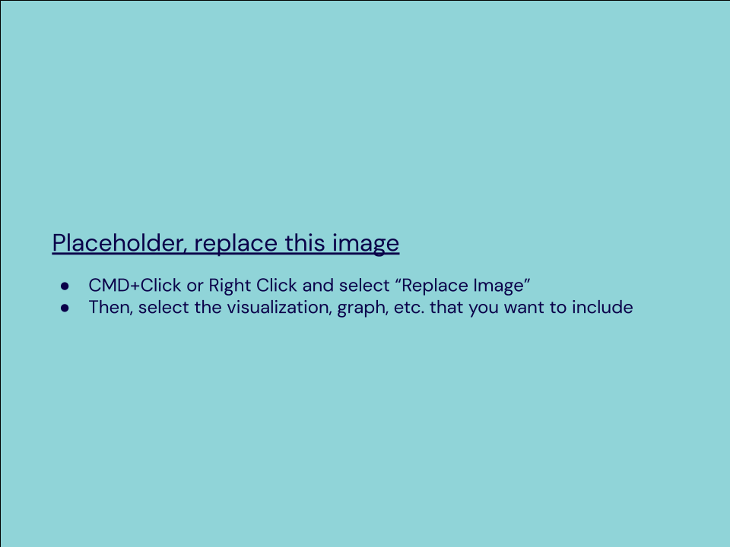
Your Data Visualization
Using Tableau, create the requested visualization (Placeholder)

Slide 9
Your Visualization Interpretation 1 of 2
What does this visualization show about the data?
Enter your answer here:

Slide 10
Your Visualization Interpretation 2 of 2
Does this visualization align with what we’ve seen so far from the data?
Enter your answer here:

Slide 11
Recommendations Based on Model Results 1 of 2
What recommendations would you give Inu + Neko based on the model results?
Enter your answer here:

Slide 12
Recommendations Based on Model Results 2 of 2
What recommendations would you give Inu + Neko based on the model results?
Enter your answer here:

Slide 13
Your Final Insights 1 of 4
What can you say about the current state of the business?
Enter your answer here:

Slide 14
Your Final Insights 2 of 4
What projections can you make about the future state of the business?
Enter your answer here:

Slide 15
Your Final Insights 3 of 4
What would you recommend to Inu + Neko?
Enter your answer here:

Slide 16
Your Final Insights 4 of 4
What more work could be done to expand on your analysis?
(You won’t need to do this but state what would be good next steps for a follow-up analysis.)
Enter your answer here:

